Slide 1

Deploying your Python Apps
Local and Web deployments

Slide 2
What is Deployment?
Deploying is making your app available for others to use.
Two common types:
Local Deployment: Create an executable (.exe, .app)
Web Deployment: Make it live on the internet

Slide 3
Local deployment => Pyinstaller
Why PyInstaller?
A tool that turns your Python app into an executable.
No need for users to install Python!
Works on Windows, macOS, and Linux.
✅ Perfect for desktop apps and scripts.

Slide 4
How to Install PyInstaller
pip install pyinstaller
✅ Tip: Always activate your virtual environment first!

Slide 5
How to Use PyInstaller (Basic)
Go to your project folder.
Run this command:
pyinstaller your_script.py
It will create:
/dist/your_script/your_script.exe
/build/
Other temporary files

Slide 6
Customizing the Build
Common options:
--onefile: Make a single .exe file.
--noconsole: Hide the terminal (for GUI apps).
pyinstaller --onefile --noconsole your_script.py

Slide 7
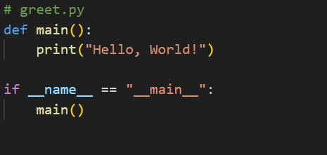
Packing a Simple App
Command to package:
pyinstalller --onefile greet.py
✅ You get a standalone greet.exe!

Slide 8
Important Notes
Large apps may create big .exe files.
Always test your executable on a clean machine (a machine without Python installed) if possible.
Windows Defender might warn — that's normal if unsigned.

Slide 9

Deploying Web Apps with Vercel
What is Vercel?
A cloud platform that hosts web apps.
Easy, fast, and beginner-friendly.
Great for deploying small APIs or websites.

Slide 10
When to Use Vercel
You have a Python web app (using FastAPI, Flask, etc.).
You want free hosting for small/medium projects.
You want automatic deployment from GitHub.

Slide 11
Basic Requirements
Vercel account (free)
GitHub account (free)
A web framework (we'll use FastAPI in the example)
vercel.json configuration file

Slide 12
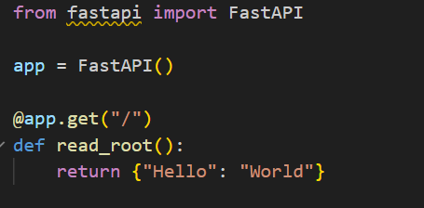
Quick intro to FastAPI
Example app (api.py):
Add to requirements.txt:
fastapi
uvicorn

Slide 13
Step by step deploy
Create a vercel.json file:
{
"builds": [{ "src": "api.py", "use": "@vercel/python" }],
"routes": [{ "src": "/(.*)", "dest": "api.py" }]
}

Slide 14
Step by step deploy
Push your code to Github
Go to vercel.com.
Create a new project ➔ Import from GitHub.
Click Deploy.
/my-vercel-app
├── api.py
├── requirements.txt
└── vercel.json
✅ The URL will be like: https://my-vercel-app.vercel.app (can customize domain later)
Add to requirements.txt:
fastapi
uvicorn

Slide 15
Recap
Use local deployment with PyInstaller for simple scripts
Use web deployment with Vercel (or other hosting platforms) for APIs or websites
Add to requirements.txt:
fastapi
uvicorn

