Slide 1

Tests in Python
Making sure your code works

Slide 2
Tests are needed
Why test?
Catch bugs early.
Save time and headaches.
Make code changes confidently.
✅ "If it's not tested, it doesn’t work."

Slide 3
Two Main Ways to Test in Python
unittest (built-in)
Comes with Python
Slightly more formal, like Java or C# style tests.
pytest (popular external library)
Simpler syntax
More powerful for bigger projects

Slide 4
Basic Testing Vocabulary
Test Case: A small test that checks one thing.
Assertion: A statement that must be true.
Test Runner: A tool that finds and runs tests.

Slide 5
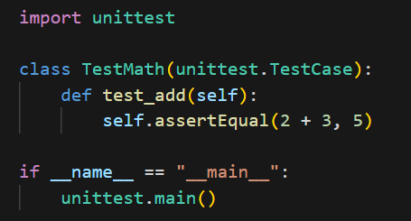
Writing Your First unittest Test

Slide 6

Useful Assertions in unittest
assertEqual(a, b): a == b
assertTrue(x): x is True
assertFalse(x): x is False
assertRaises(Exception): expected an error

Slide 7
How to Run unittest
Save your test file (example: test_math.py).
Run from the terminal:
python test_math.py
Tests will show OK or FAILED automatically.

Slide 8
pytest
External tool (install it first).
Much simpler syntax, no classes needed.
Very popular in real-world projects.
How to install:
pip install pytest

Slide 9
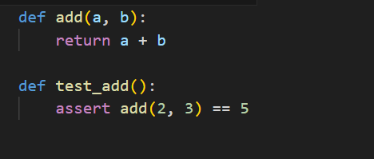
Writing Your First pytest Test
Create a function starting with test_.
Use normal assert statements.

Slide 10
How to Run pytest
Save your test file (example: test_math.py).
Run in terminal from the project root:
pytest
✅ pytest automatically finds all files named test_*.py.

Slide 11
Some pytest Advantages
Cleaner test code.
Better error messages.
Easier to scale when the project grows.
Works nicely with plugins (e.g., coverage, mocking).

Slide 12
Comparison
Feature | unittest | pytest
Comes with Python? | Yes | No
Syntax difficulty | Medium | Very easy
Advanced features? | Medium | High
Popularity | High (traditional) | Very high (Modern)

Slide 13
Recap
Testing ensures your code actually works.
unittest: built-in, class-based style.
pytest: simpler, function-based style.
Always test your important logic!

