Slide 1

Automation
Getting rid of repetitive tasks

Slide 2
Introduction to Automation
Automation allows you to program repetitive tasks to save time and reduce errors.
Automate web interactions with Selenium
Schedule tasks with libraries like schedule or cron
Process documents, spreadsheets, and files automatically
Create bots for various platforms and services

Slide 3
Why Automate?
Automation offers numerous benefits for developers and businesses.
Save time on repetitive tasks
Reduce human error
Increase consistency and reliability
Scale operations more efficiently
Free up human resources for creative work

Slide 4
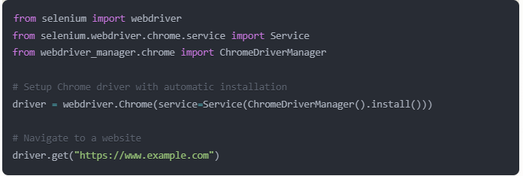
Selenium - Web Automation
Selenium is a powerful tool for controlling web browsers through Python.

Slide 5
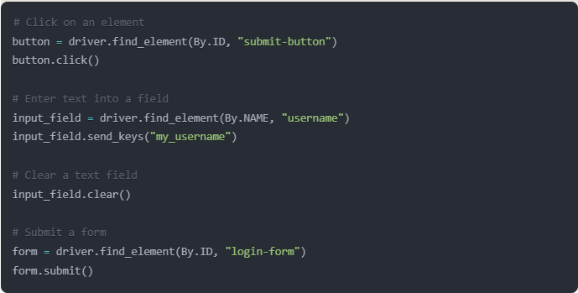
Interacting with Elements
Selenium can simulate user interactions with webpage elements.

Slide 6
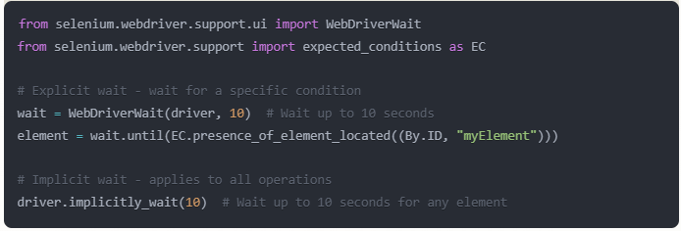
Waiting for Elements
Waiting mechanisms ensure elements are available before interacting with them.

Slide 7
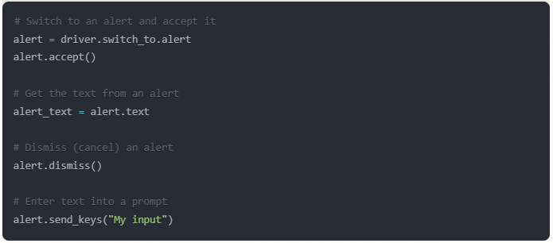
Handling Alerts and Popups
Selenium can interact with JavaScript alerts, confirms, and prompts.

Slide 8
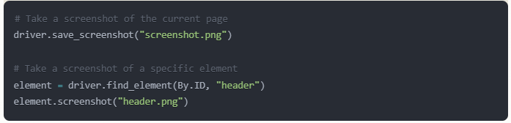
Taking Screenshots
Selenium can capture screenshots for debugging or documentation.

Slide 9



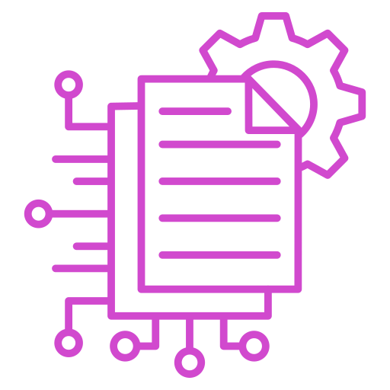
Other types of automation
Mouse and Keyboard
Schedule
Files and Emails
Data Extraction
PyAUTOGUI
schedule, time
os, shutil and glob
email and smtplib
BeautifulSoup

Slide 10
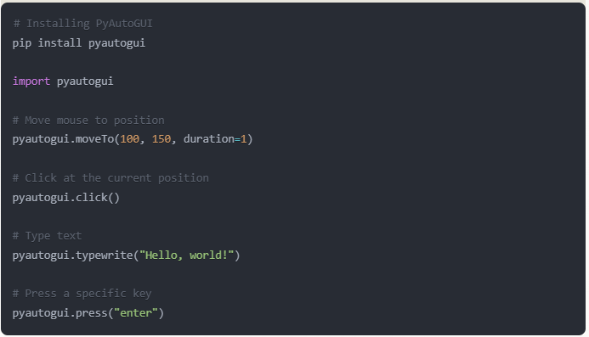
PyAutoGUI
Helps automate mouse and keyboard actions across your system.

Slide 11
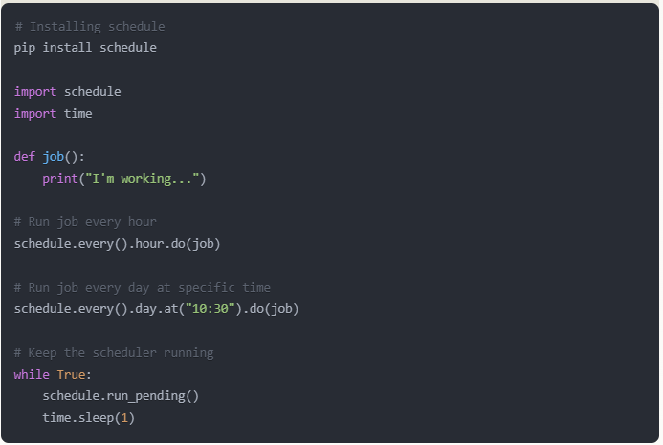
Scheduling Tasks
The schedule library helps run Python functions on a schedule.

Slide 12
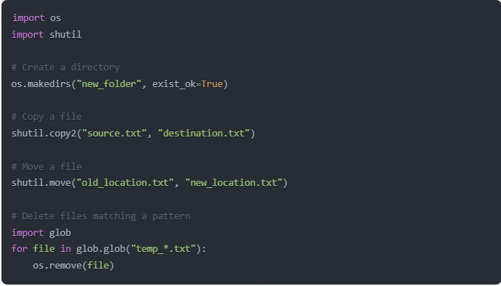
Automating file operations
The schedule library helps run Python functions on a schedule.

Slide 13
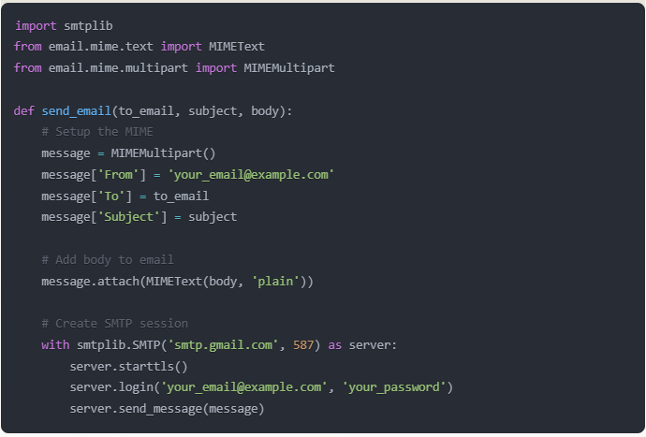
Automating email
Send emails automatically using Python's email and SMTP libraries.

Slide 14
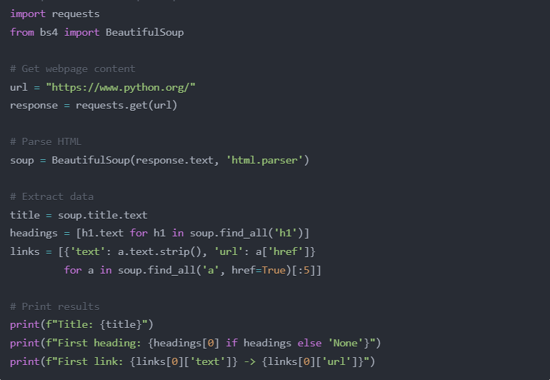
Data Extraction
Beautiful Soup complements Selenium for parsing and extracting web content.
We also call this activity Data Scraping

Slide 15

It’s code time!

