Slide 1

APIs and Data Consuming
How to use data from other services

Slide 2

What are APIs?
Think of an API as a waiter in a restaurant:
You (the client) order food from the menu
The waiter (API) takes your request to the kitchen
The kitchen (server) prepares what you ordered
The waiter returns with your food (data)

Slide 3
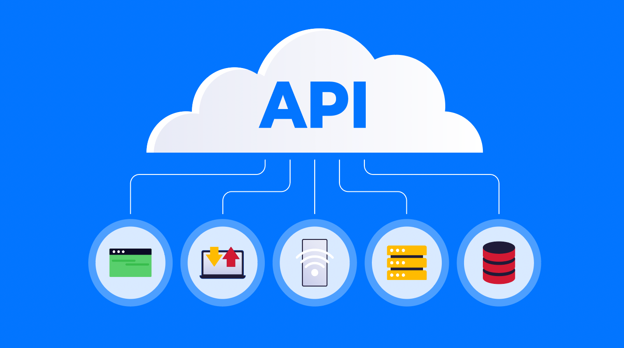
Why use APIs?
APIs enable developers to:
Access functionality from other applications
Retrieve data from external services
Integrate different systems together
Build on existing platforms without reinventing the wheel

Slide 4
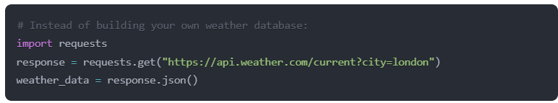
Practical Example: Weather API

Slide 5
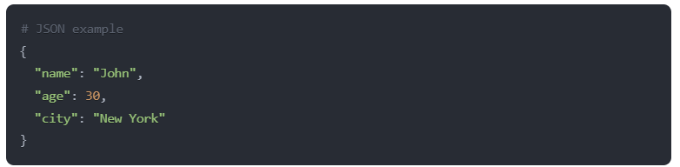
API data formats
APIs typically exchange data in structured formats:
JSON (JavaScript Object Notation) - Most common
XML (eXtensible Markup Language)
YAML (YAML Ain't Markup Language)

Slide 6
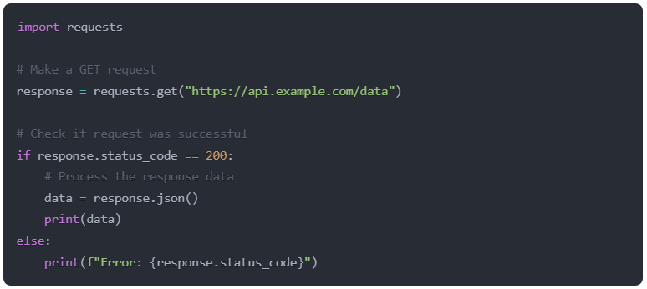
API requests in Python
Python's requests library makes it easy to work with APIs:

Slide 7
Authentication
Many APIs require authentication to:
- Identify users
- Control access
- Track usage
- Protect private data
Common authentication methods:
- API Keys
- OAuth
- JWT (JSON Web Tokens)

Slide 8
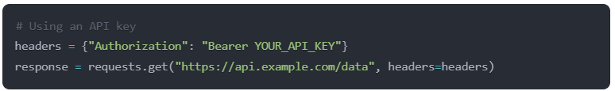
Authentication Example - API Key

Slide 9
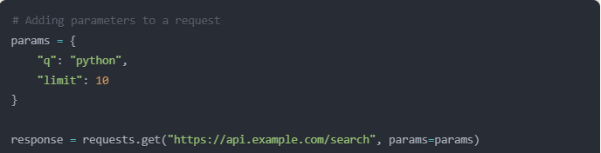
Request Parameters
Parameters allow you to customize your API requests.
- This creates a URL like: https://api.example.com/search?q=python&limit=10

Slide 10
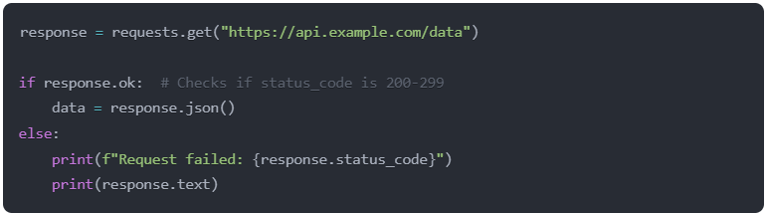
Handling API Responses
Always check the response status:
200s: Success (200 OK, 201 Created)
300s: Redirection
400s: Client errors (404 Not Found, 401 Unauthorized)
500s: Server errors

Slide 11
Best Practices
Documentation
Authentication
Error handling
Rate limits
Always read the documentation
Keep your credentials secure
Handle errors with try-except blocks
Respect API rate limits

Slide 12

It’s code time!

