Slide 1

Object Oriented Programming (OOP)
Classes, objects, attributes and methods

Slide 2
What is Object Oriented Programming?
Object-Oriented Programming (OOP) is a programming paradigm that models real-world objects using code.
Organizes code into objects
Promotes reusability and modularity
Helps manage complex programs

Slide 3
Key Concepts
Class – A blueprint for creating objects
Object – An instance of a class
Attributes – Variables inside a class
Methods – Functions inside a class that define object behavior

Slide 4
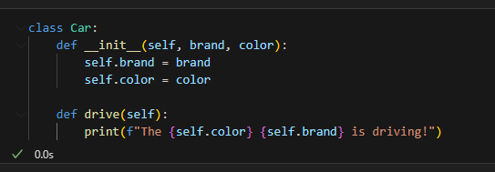
Key Concepts
Class – A blueprint for creating objects

Slide 5
Key Concepts
Class – A blueprint for creating objects
Object – An instance of a class

Slide 6
Key Concepts
Class – A blueprint for creating objects
Object – An instance of a class
Attributes – Variables inside a class

Slide 7
Key Concepts
Class – A blueprint for creating objects
Object – An instance of a class
Attributes – Variables inside a class
Methods – Functions inside a class that define object behavior

Slide 8
Remember this?
‘Is’ Methods
isdigit()
isalnum()
digits
letters or digits
Boolean result
isalpha()
islower()
alphabet letters
lowercase letters
Use these functions to check whether ALL the characters in a string are of a given type
isupper()
isspace()
uppercase letters
blank spaces (spaces, line breaks or tabulation)

Slide 9
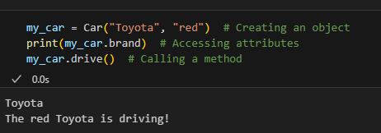
Creating and Using Objects
A class defines a structure, and an object is an instance of that structure.
Objects store data and have behaviors.
You can create multiple instances from the same class.

Slide 10

The __init__ method
The __init__ method is a special method that runs when an object is created. It initializes the object's attributes.
__init__ ensures every object is properly initialized.

Slide 11
Creating and Using Objects
Class – A blueprint for creating objects
Object – An instance of a class
Attributes – Variables that store object data
Methods – Functions inside a class that define object behavior

Slide 12

It’s code time!

