Slide 1

Error handling
Try, except and best practices

Slide 2
Error handling in Python
Errors are common in programming. Python provides tools to handle errors gracefully, preventing program crashes.
Use try and except to catch errors.
Handle specific exceptions for better debugging.
Follow best practices to write reliable code.

Slide 3
What causes errors?
Errors happen when Python cannot execute a command.
Common error types:
SyntaxError → Incorrect Python syntax
NameError → Using a variable that doesn't exist
TypeError → Incompatible data types
IndexError → Invalid list index
KeyError → Invalid dictionary key
ZeroDivisionError → Dividing by zero

Slide 4
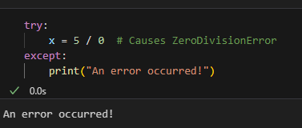
Try, except
Use try to test code and except to catch errors.
The program won't crash even if an error happens.

Slide 5
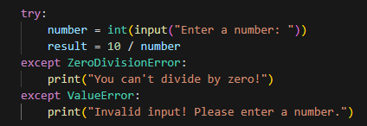
Handling Specific Errors
You can handle specific exceptions differently.
This ensures more precise error handling.

Slide 6
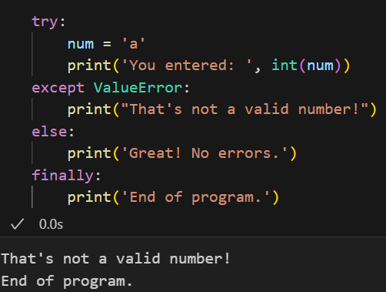
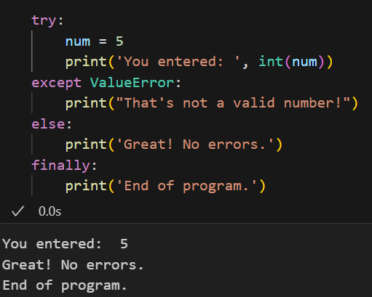
Using else and finally
else runs if no error occurs.
finally always runs, even if there is an error.

Slide 7

Raising custom errors
Use raise to create custom error messages.
Helps prevent invalid input early.

Slide 8
Best practices
Be specific
Keep try blocks small
Log errors for debugging
Don’t ignore errors
Avoid “except:”
Use custom errors
Use it only where errors might appear
Using print()
Save them to a file
Fix errors whenever possible

Slide 9

It’s code time!

