Slide 1

File Manipulation
How to work with text and JSON files

Slide 2
How to work with files in Python
Python allows you to read, write, and manage files, making it easy to store and retrieve data.
Work with text files (.txt) to save and read simple data.
Use JSON files (.json) for structured data, useful for APIs and databases.
Prevent errors by properly opening and closing files.

Slide 3
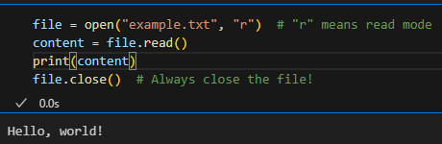
Working with .txt files
To open a file, use the open() function.
Use "r" for reading, "w" for writing, "a" for appending.
Always close the file to avoid issues.

Slide 4
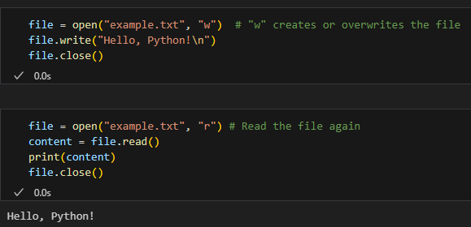
Writing to a .txt file
To write data to a file, use "w" mode.
Overwrites existing content (be careful!).
Use "a" mode to append instead of overwrite.

Slide 5
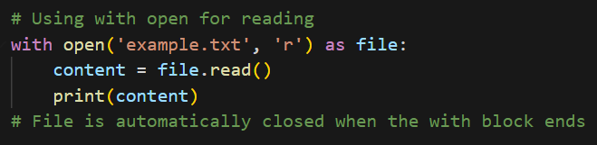
Best practice - use with open
The with open() statement automatically closes the file after use.
Cleaner and safer way to handle files.

Slide 6
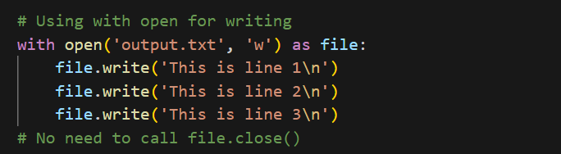
Best practice - use with open
The with open() statement automatically closes the file after use.
Cleaner and safer way to handle files.

Slide 7
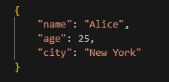
Working with JSON files
JSON = JavaScript Object Notation
It is a structured format used for data exchange.
Example:
JSON is widely used in APIs, databases, and configurations.

Slide 8
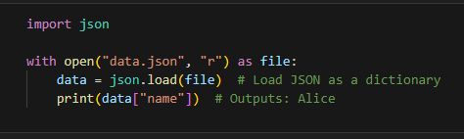
Reading JSON files
Use the json module to work with JSON.
json.load() converts JSON into a Python dictionary.

Slide 9
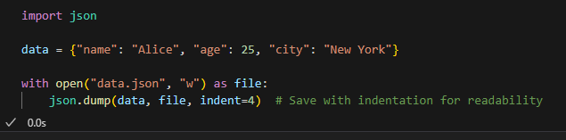
Writing JSON files
Use the json module to work with JSON.
json.dump() converts a Python dictionary into a JSON file.

Slide 10

It’s code time!

