Slide 1

Functions
A great way to perform specific tasks

Slide 2
What are functions?
Functions are reusable blocks of code that perform specific tasks. They help make programs:
Easier to read - Organizing code into smaller sections
More efficient - Avoid repeating the same code
Reusable - Call the same function multiple times

Slide 3
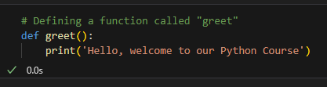
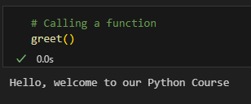
Defining and calling Functions
To create a function in Python, use the def keyword.
To call (execute) a function, use () after the function name.

Slide 4
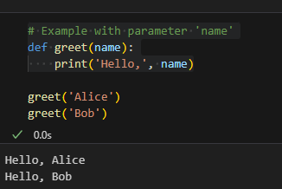
Parameters and Arguments
Functions can accept input values (parameters) to work with different data.
Parameters allow functions to be more flexible.
Arguments are the actual values passed to the function

Slide 5
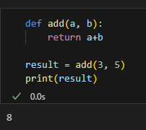
Defining and output -> Return
A return statement is used to send back a value to where the function is called.
Without a return statement, the function simply executes but doesn’t store any result.

Slide 6
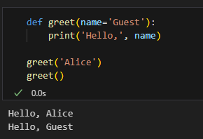
Default parameters
Functions can have default values for parameters.
When an argument is optional, default values are useful.
If no value is provided, the function uses the default.

Slide 7
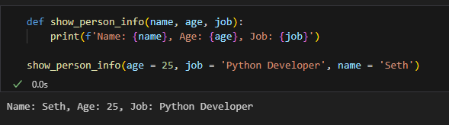
Multiple parameters
When a function has multiple parameters, it is useful to use the keyword arguments for clarity.
Keyword arguments avoid confusion when passing multiple values.

Slide 8
Scope of variables
Variables inside a function have local scope, meaning they exist only within the function.
Variables inside a function cannot be accessed outside.
Variables defined outside the function can be used inside them, but be careful with similar names.

Slide 9
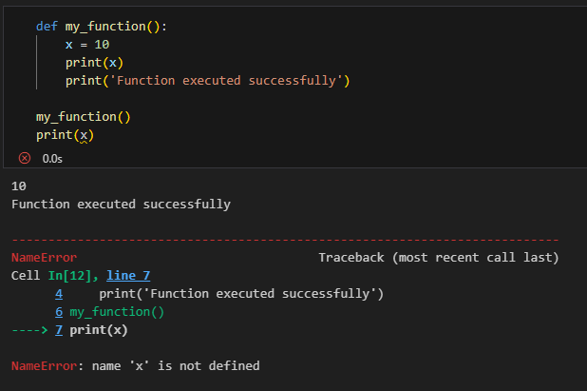
Scope of variables - Example

Slide 10

It’s code time!

