Slide 1

Data Structures
Lists, Tuples, Dictionaries, and Sets

Slide 2
What are data structures?
Python provides multiple data structures to store and manage data efficiently.
Lists
Tuples
Dictionaries
Sets
Each has unique properties and use cases!

Slide 3
Summary
Lists
Sets
Tuples
Dictionaries
Ordered
Mutable
Allow duplicates
Unordered
Mutable
No duplicates allowed
Ordered
Immutable
Allows duplicates
Ordered*
Mutable
No duplicate keys
* after Python 3.7

Slide 4
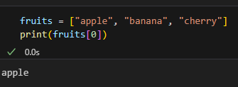
Lists
A list is a collection of items stored in a specific order. Lists are mutable, meaning you can add, remove, or change elements.
Key Features:
Ordered (keeps elements in the order they were added).
Supports duplicates.
Can store different data types (integers, strings, even other lists).

Slide 5

Lists - Common operations

Slide 6
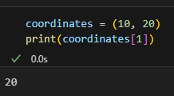
Tuples
A tuple is similar to a list, but it is immutable (cannot be modified after creation).
Key Features:
Ordered (items keep their positions).
Useful for fixed data collections.
Cannot add, remove, or modify elements.

Slide 7
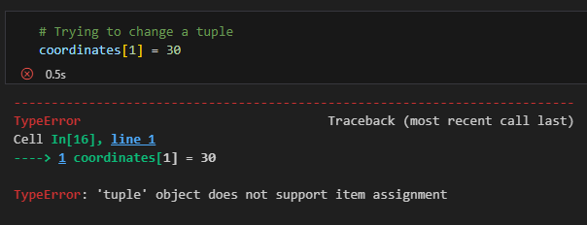
A tuple throws an error if you try to change it

Slide 8
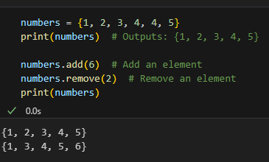
Sets
A set is an unordered collection where each item is unique.
Key Features:
Removes duplicates automatically.
Unordered – does not support indexing or positions.
Useful for removing duplicates or checking common elements between collections.

Slide 9
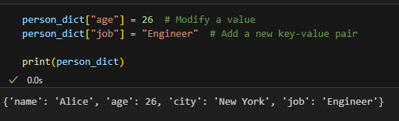
Dictionaries - Example code

Slide 10
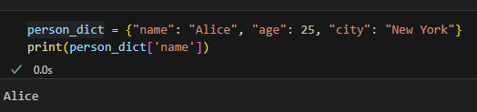
Dictionaries
A dictionary stores data in a key: value format, allowing quick lookups.
Key Features:
Fast access using keys instead of indexes.
Keys must be unique, but values can be repeated.
Can store different data types (numbers, lists, other dictionaries).
Mutable – you can add, remove, or change items.

Slide 11
Dictionaries - Example code

Slide 12
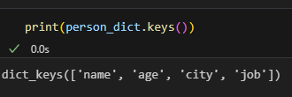
Dictionaries - Example code 2

Slide 13
Review Summary
Lists
Sets
Tuples
Dictionaries
Ordered
Mutable
Allow duplicates
Unordered
Mutable
No duplicates allowed
Ordered
Immutable
Allows duplicates
Ordered*
Mutable
No duplicate keys
* after Python 3.7

Slide 14
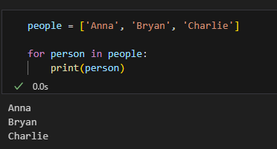
Iterating data structures
Remember the for loop?

Slide 15
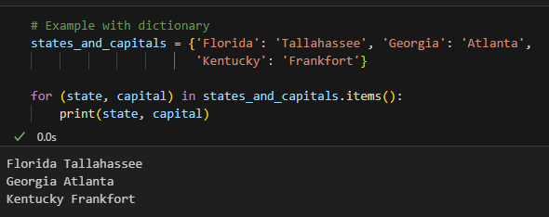
Now with a dictionary
Remember the for loop?

Slide 16

It’s code time!

