Slide 1

Basic structures
Variables, data types and operators

Slide 2
Agenda
01
Variables
02
Data types
03
Operators

Slide 3

01
Variables

Slide 4

What is a variable?
Definition
Python specifics
A container for storing data
Think of it as a labeled box that holds information
No need to declare a type to create the variable
Variable names are case-sensitive
Variable names can’t start with numbers or special characters (except _)

Slide 5
02
Data Types

Slide 6
Overview of Data Types
A data type defines the set of values a variable can assume.
Numbers: integers, float
Text: strings
Booleans: True or False
Collections: lists, tuples, dictionaries, sets
Python is dynamically typed, so you do not have to specify the type when defining a variable.
Notes:
As opposed to strongly typed

Slide 7
Numbers
Integers
Float
A whole number such as: 3, 5, 8 but also -1 or -3. Integers do not include fractions or numbers with a decimal place.
Comes from “floating point”. Any number that has decimals. 3.14, -7.5 or 0.0.

Slide 8
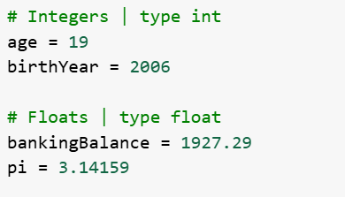
Numbers - Example code

Slide 9
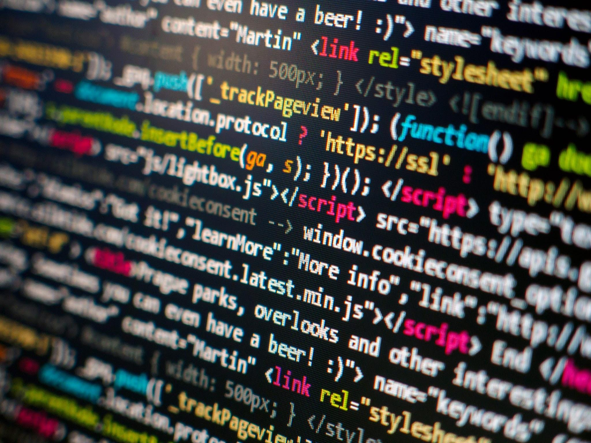
Strings
Strings are sequences of characters, including letters, numbers and symbols.
Text between quotes (single, double or triple) are strings.
Example: x = “Hello, world”

Slide 10
When to use each type of quotes
Single ‘ ’ | Double “ ” | Triple ‘’’ ‘’’
When the text itself contains double quotes. E.g.: text = ‘He said “Oh my God” ‘ | When the text itself contains single quotes. E.g.: “She’s electric.” | If we need to write text in more than one line or the text itself contains single or double quotes.

Slide 11
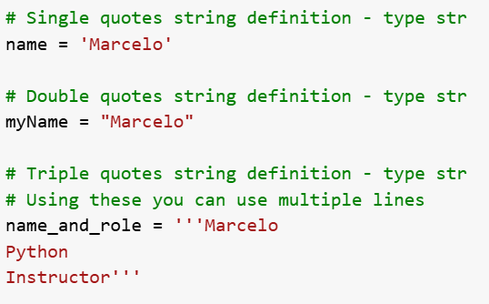
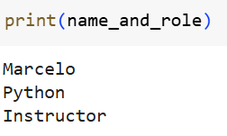
Strings - Example code

Slide 12
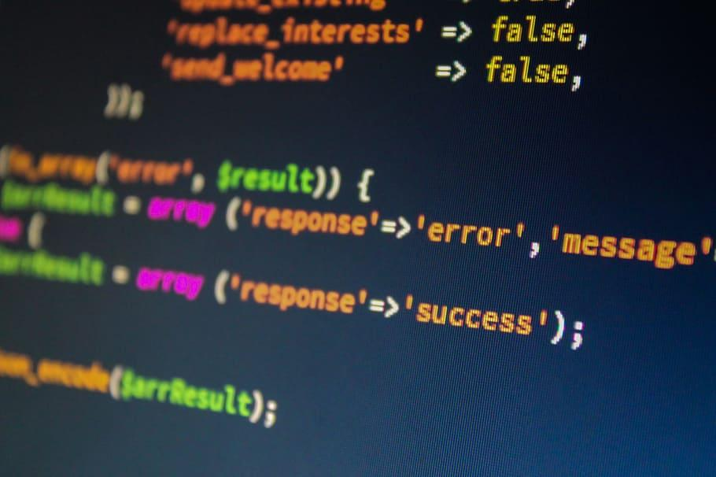
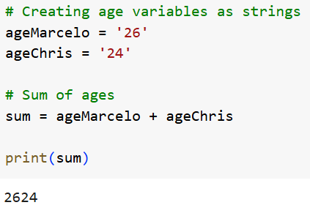
Treating numbers as strings
When we treat numbers as strings, we might get undesired results.

Slide 13
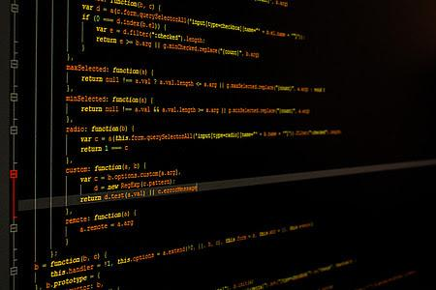
Booleans
In Python, a boolean type (bool) is a data type that can only take two values: True or False. They are very useful in conditional expressions and loops, which we will see later.
To create a boolean value, we can simply compare expressions, or define a variable with True or False values.
x = True creates a variable named x with the value True.

Slide 14
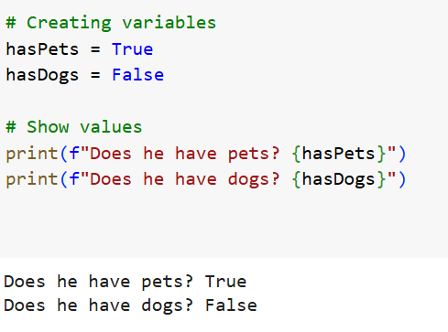
Booleans - Example code

Slide 15
‘Is’ Methods
isdigit()
isalnum()
digits
letters or digits
Boolean result
isalpha()
islower()
alphabet letters
lowercase letters
Use these functions to check whether ALL the characters in a string are of a given type
isupper()
isspace()
uppercase letters
blank spaces (spaces, line breaks or tabulation)

Slide 16
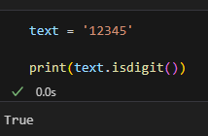
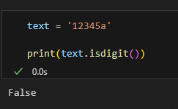
‘Is’ Methods - Examples

Slide 17
‘Is’ Methods
isdigit()
isalnum()
digits
letters or digits
Boolean result
isalpha()
islower()
alphabet letters
lowercase letters
Use these functions to check whether ALL the characters in a string are of a given type
isupper()
isspace()
uppercase letters
blank spaces (spaces, line breaks or tabulation)

Slide 18
Type Conversion
In most daily tasks we need to convert one type of data into another. We might need to convert an integer in a string to show it on the screen or convert a string in a number to perform calculations.
str
float
int

Slide 19
Integer Conversion
Use the function int()
str -> int
float -> int
bool -> int
Used to convert text to integer. For example: “20” to 20. Note that isdigit() must return True. Otherwise there will be a conversion error.
int(“20”) -> 20
Used when we need to convert a number with a floating point to an integer (for example, 3.45 to integer). Here we perform a truncation (remove the decimal part)
int(3.45) -> 3
Used to convert a boolean to int. True will be converted to 1 and False to 0
int(True) -> 1

Slide 20
Float Conversion
Use the function float()
str -> float
int -> float
bool -> float
Used to convert text to float. For example: “20.98” to 20.98. Note that isdigit() might return False due to ‘.’.
float(“20.98”) -> 20.98
Used when we need to convert a float to an integer. A “.0” will be added to the end of the number.
float(3) -> 3.0
Used to convert a boolean to float. True will be converted to 1.0 and False to 0.0
float(True) -> 1.0

Slide 21
String Conversion
Use the function str()
int -> str
float -> str
bool -> str
Converts an integer to string.
str(20) -> “20”
Converts a float to string.
str(3.14) -> “3.14”
Converts a boolean to text. “True” and “False” will now be a string and will not have a boolean meaning.
str(False) -> “False”

Slide 22
Boolean Conversion
Use the function bool()
str -> bool
float -> bool
int -> bool
Used to convert a string to boolean. Whenever the string is not empty (e.g.: “”) the value will return True.
bool(“Hi”) -> True
Converts a float to boolean. When the number is not 0.0, the value will return True.
bool(3.14) -> True
Converts an integer to boolean. Whenever the number is not 0, the value will return True.
bool(3) -> True

Slide 23
03
Operators

Slide 24
Operators
Arithmetic
Comparison
Logical
Perform basic math
Compare values and return True or False
Combine conditions

Slide 25
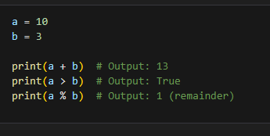
Operators - Example code

Slide 26
Next up
01
02
03
04
Flow control
Data structures
Input/Output
Project 1
How to set conditionals and avoid code repetition
How to store variables as groups
How to handle multiple inputs and format outputs
One more step towards Python mastery

