Slide 1

Introduction to Python

Slide 2
Agenda
01
What is Python?
02
Why is Python So Popular?
03
04
Python Syntax Basics
First Python Commands

Slide 3
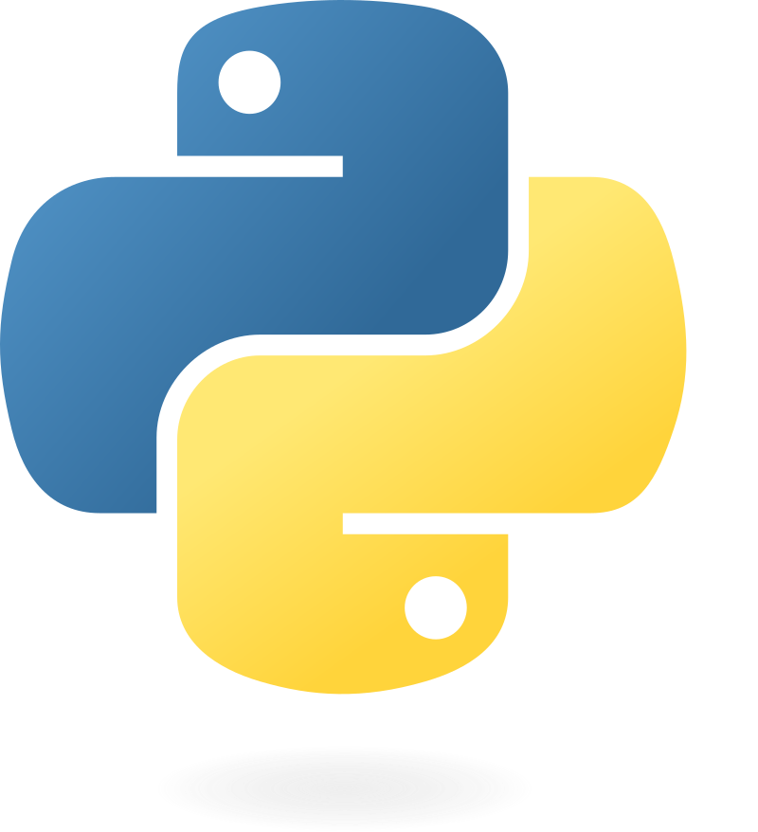
What is Python?
A high level programming language known for its simplicity and readability
Used in web development, data science, automation and more

Slide 4
Why is it so popular?
Simple and easy-to-read syntax
Large community and extensive libraries
Cross-platform compatibility
Used in diverse fields (AI, data science, web development, automation)

Slide 5
Why is it so popular?
Example usage areas:
Web frameworks like Django and Flask
Data analysis with Pandas
Machine learning with TensorFlow and Scikit-Learn

Slide 6
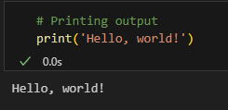
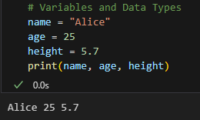
Basic syntax
Rules
Example code
Python’s syntax is simple and easy to understand:
No need for semicolons (;)
Uses indentation instead of curly brackets {}
Readable and clean code structure

